Slide 1
Puzzle of the Day
public class LongDivision {
public static void main(String[] args) {
final long MICROS_PER_DAY = 24 * 60 * 60 * 1000 * 1000;
final long MILLIS_PER_DAY = 24 * 60 * 60 * 1000;
// HINT: 1000
System.out.println(MICROS_PER_DAY / MILLIS_PER_DAY);
}
}
What does this program do?
Notes:
The x you computed, in the integer range, was 500654080. This divided by the y ( = 86400000), results in 5.794607407407407.... Java truncates the decimal part which causes the 5. By adding an L after the number literal, you tell the compiler to compile it as a long instead of an int. The value for x you expected is 86400000000. But is was compiled as an int. We can reproduce the wrong value for x (500654080) by truncating it to an int.
Some languages don't do this, but support target typing, a language feature wherein the type of the variable in which a result is to be stored influences the type of the computation.

Slide 2
Puzzle of the Day - Solution
public class LongDivision {
public static void main(String[] args) {
final long MICROS_PER_DAY = 24L * 60L * 60L * 1000L * 1000L;
final long MILLIS_PER_DAY = 24L * 60L * 60L * 1000L;
// HINT: 1000
System.out.println(MICROS_PER_DAY / MILLIS_PER_DAY);
}
}
Notes:
The x you computed, in the integer range, was 500654080. This divided by the y ( = 86400000), results in 5.794607407407407.... Java truncates the decimal part which causes the 5. By adding an L after the number literal, you tell the compiler to compile it as a long instead of an int. The value for x you expected is 86400000000. But is was compiled as an int. We can reproduce the wrong value for x (500654080) by truncating it to an int.
Some languages don't do this, but support target typing, a language feature wherein the type of the variable in which a result is to be stored influences the type of the computation.

Slide 3
Evening Exam 1
Check Moodle for schedule and room assignment
Extra time people:
Send me an email now formally requesting extra time
Provide me with your documentation if you have not already this term
Any questions on the exam format?
Optional exam review studio/design signoff session Tuesday during class

Slide 4
The Decorator Pattern
Week 3-1

Slide 5
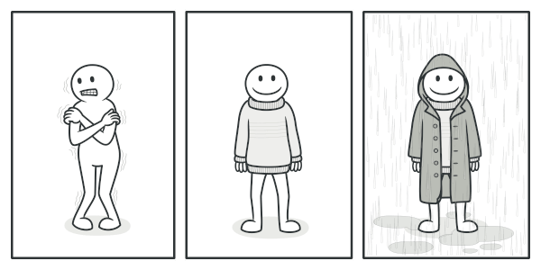
Decorator Design Pattern
Used when you need to attach additional responsibilities to an object dynamically
Decorators provide a flexible alternative to subclassing for extending functionality
Bit like Dressing these days… ☺
Notes:
Probably familiar with “Publish and Subscribe” which is a complex form of Observer and often called out as a Design Pattern itself.

Slide 6
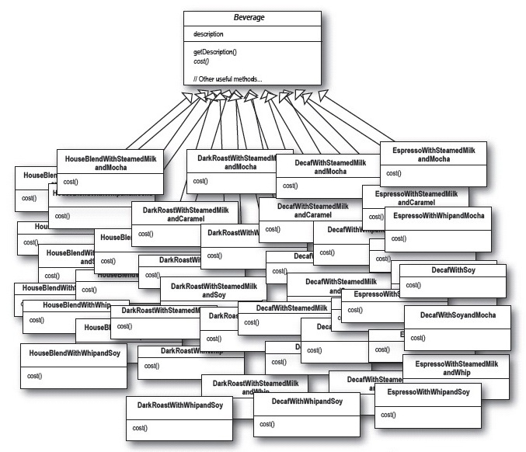
Decorator: Motivation
Desire to add responsibilities to individual objects
Approaches
Inheritance
Choices are made statically
Inflexible
Decorator
Dynamic
Unlimited in number of added responsibilities
Coffee
description
getDescription()
Cost()
…
Coffee
Inheritance
Abuse!

Slide 7
Questions on the reading…
Would it make sense to use an inverted decorator pattern where the base class holds a Collection of abstract decorators?
Is it possible to have decorators on decorators?
Notes:
Superclasses should not know about their subclasses, including abstract decorators. But superclasses might compose themselves and that composition could be implemented using abstract decorator.
Sure. A decorator might start with a strategy. That strategy might need to be extended with additional functionality. Rather than editing the decorator+strategy, you could just decorate the strategy.

Slide 8
More examples?
Anything you could imagine handling with:
Inheritance
Calling super.something()
Where instanceof is not allowed
Example: separating access control from business logic
Do you seed every method with if(AccessControl.notAllowed()){ throw new AccessControlException(…); }
Or is there some better way, without editing the existing code?

Slide 9
More examples?
Add a backdoor into Java’s SecurityManager
Graphics transformations
Many more; I will ask you about them all throughout the term

Slide 10
Is debugging harder?
This sounds like a really cool alternate to tons of sub-classing, but I was wondering whether this would cause more problems on the debugging side if we had a base set of more complicated components and many attached modifiers.
Notes:
A little, abstract decorator gets in the way.

Slide 11
Making the best of a bad design
In question 2, using the getters and setters is the best way to solve the problem. Previously we've discussed that getters and setters are usually not good design. Can you explain why they are good in this situation?

Slide 12
Will we use Decorator?
As far as I can tell, Decorators do not seem to have a use in the Project. Will there be a lab associated with them so we can get experience with them?
Notes:
Decorator will be featured prominently.

Slide 13
Which pattern should you use?
Are there any tells that can help you decide when to use this design pattern?
I understand the usefulness of Decorators, and it seems clear that for the coffee example, Decorators were necessary. However, I am unsure if I would be able to tell which pattern would be the best to use in a real world scenario. Is there an easy way to determine which pattern is best to use?
Notes:
Deciding on which pattern to use is the wrong approach.
Patterns are just very specific examples of the design principles.
You apply the design principles to a problem and arrive at something that coincidentally looks like the pattern.

Slide 14
Does Decorator favor composition?
Can we talk about how this class relates to the idea of favoring composition over inheritance?
I am a little confused on inheritance versus Composition in the decorator pattern. Can we clarify the two differences between them?

Slide 15
Why use Decorator for condiments?
I still don't quite understand when this would be more useful than an interface. For instance, the coffee shop example in the book would work way better, as far as I can tell, with an interface for condiments so that an employee could remove condiments when consumers change their mind.
Notes:
Freeman has a whole spiel on this.
The premise of the Coffee example is that we do not want to go back and add knowledge of added ingredients to the Coffee.
The thinking is that Coffee should be Coffee and not know about condiments.
We want to add this new behavior without changing the base class at all.

Slide 16
What do you think of this idea?
The book mentions that checking for concrete components doesn't work as well with the decorator pattern (the example given was a discount on Houseblend), but couldn't you write methods to check through the types of what is being decorated without it getting too complicated?

Slide 17
Business logic and Decorator
Suppose it is not possible to put a whip decorator on a certain type of coffee. How to we deal with decorators that cannot be applied to all of the subclasses of the superclass?
The point of the class is composition, but by hiding everything behind an interface it becomes difficult for multiple components to correctly act together. For example Mocha(Mocha(Soy)) => DoubleMocha(Soy) when printed but that then relies upon programming to an implementation.
Notes:
Here is where Decorator struggles.
Decorator follows all of the tenets of object-oriented design.
But those tenets often conflict with weird business logic like this.

Slide 18
Too many Decorators?
Are there any problems that arise from developers creating "too many layers" of decorators?
Should we apply decor pattern to all the code in a project or as much as possible?
Notes:
Hard to construct – need an additional pattern.

Slide 19
What students always get wrong
In what ways can decorators go wrong?
I'm not entirely clear on why we need to superclass the decorator, rather than use an interface for it.

Slide 20
Live Coding
The Starbuzz Coffee

